Slide 1
CampusCompass
Members: Anay, Giovanni, William, & Ignatius
Group 4
Front End: Ignatius and Giovanni
Backend: Anay and William

Slide 2
Project Idea
Why is it unique?
We will include a hyperlink feature to the UF campus map to find a student’s classes, it is also an all-in-one calendar, planner, and to-do-list.
How does it address the challenge?
It allows students to organize their schedules and have all of their information in one handy website.

Slide 3
Description
Languages: Python, Javascript, HTML, CSS
Frameworks: React + Tailwind CSS, Flask?, MongoDB
Libraries/Tools: Google OAuth 2.0,

Slide 4
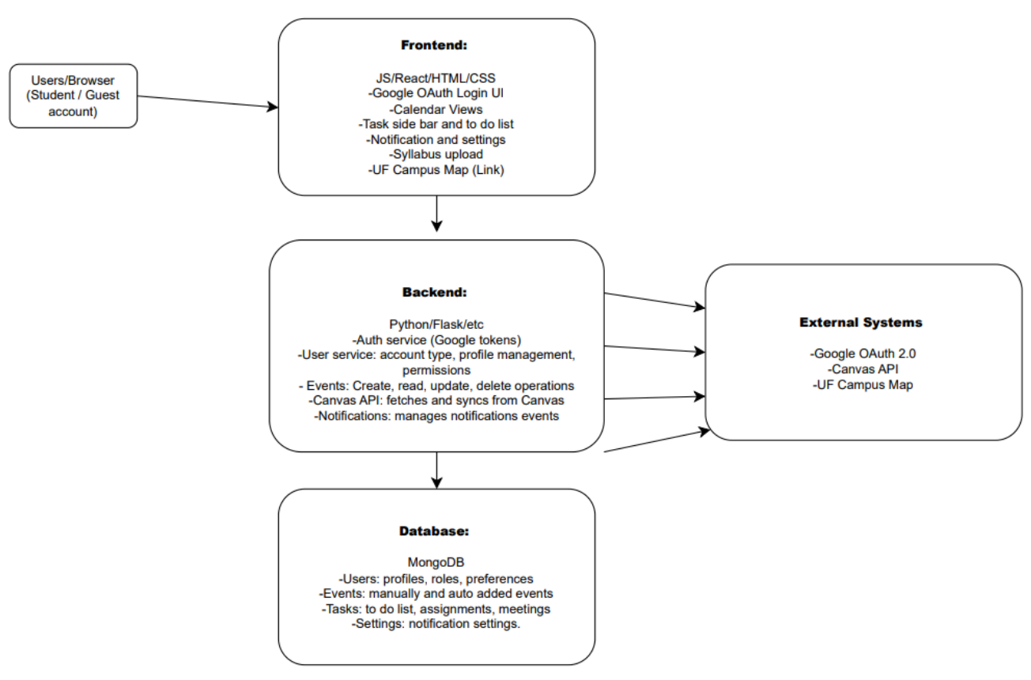
Architecture

Slide 5
Risk Explanation | Risk Probability | Risk Effect | Risk Category
Potential permission assignments can be misassigned, leading to users accessing private data or misusing features | Medium | High | Critical
Possible data breaches due to lack of security and user privacy | Low | High | Moderate
Improper/errors in front end and backend communication | Low | Serious | Low

Slide 6
Risk | Avoidance Strategy | Minimization | Contingency Strategy
Potential permission assignments can be misassigned | Use clear rules for administrator and student logins | Actively check role permissions | Revoke any permissions that are not assigned correctly
Data breaches due to lack of security | Ensure minimum requirements for password | Limit access to only users who are logged in | Secure accounts that are compromised
Errors in communication | Test data continuously | Correct errors as they appear | Reload the page

Slide 7
User Story
As a college student, I want to be able to save my data onto my own private account so that my privacy is protected.
-guest mode and user mode
-user mode has features while guest mode is view only
As a college student, I want to see where my classes are so that I can easily find my way to the correct location.
-hyperlink will show location of class

Slide 8
Rank | Backlog Item | Reasoning | Poker Score | Person Responsible
1 | Authentication system- login and sign up, storing user info | Without this the app extremely unsafe and many individuals data will be breached | 8 | Anay + William
2 | Connect to canvas API | Need this function for the app’s core purpose to work | 5 | Ignatius/Anay+William
3 | Calendar View- viewing month, day, and week | Need the user to be seeing stuff | 13 | Giovanni + Ignatius
4 | User permission - user and guest/viewer roles | Adds control/security 8 | 5 | Anay + William
5 | Event Types and studying features and notifications | Enhances the users experience | 8 | Whole team
6 | Task sidebar, sorting | Also is an enhancement for user experience | 5 | Giovanni

Slide 9
Sprint 1 Backlog w/ Velocity and Capacity
Explain your Sprint 1 backlog with estimations of velocity and capacity
Velocity (how much work needs to be done per sprint) = total number of PBI points / 2 sprints
Velocity = 44 / 2 sprints = 22 story points per sprint
Capacity (how much work is possible per sprint) = group size * number of hours per week * 2 weeks
Capacity = 4 * 2.5 * 2 = 20 hours per sprint
This means that we should be able to meet our sprint goals every week with little to no backlog

Slide 10
What’s next?
Potential issues:
.env file clarification
Learning libraries/tools (Google OAuth)
Incorporating unit testing
Next steps:
Decide APIs
Begin allocated tasks

